Slide 1


Strategic Planning - Towards 2025
Its time to shift

Slide 2
Agenda
Why Strategic Planning and why it pays?
What are the usual failures of Strategic Plans?
Why the approach to Strategic Planning must shift?
What are the shifts?
What does the leader need to do differently?

Slide 3
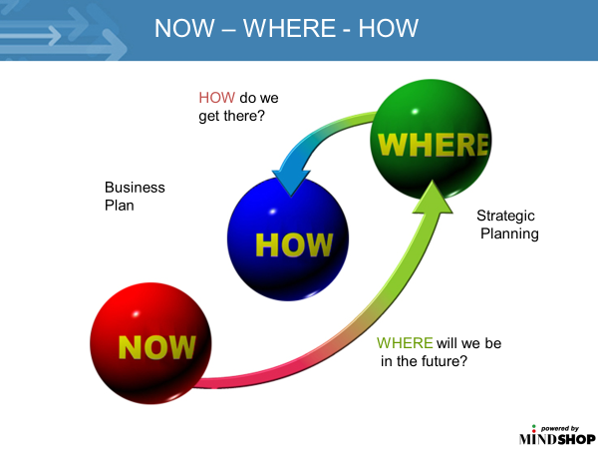
Why Plan?
When we build a building, we plan more upfront…in business its not much different. Good strategic planning should:
Puts leader in CONTROL
Act as a FILTER – where we play
MINIMISES external THREATS
ALIGN a team
DELIGHT our customers
Lead to good FINANCIAL PERFORMANCE
LIFT team CAPABILITY
IMPROVE systems

Slide 4
What are the usual failures of Strategic Plans?

Slide 5

Why Strategic Planning gets a bad name?
Annual TICK THE BOX
No EXTERNAL reality check
Plan NOT OWNED
Strategy by AGENDA time
POOR execution - 30% chance of success
POOR team skillset

Slide 6
Why the approach to Strategic Planning must shift?

Slide 7
What is driving the need to shift?
Strategic Planning by TIMETABLE
VUCA world
Exponential rise of TECHNOLOGY
Plans are lacking CREATIVITY
Striving for the perfect plan blocks a GOOD EXECUTABLE plan

Slide 8
What are the six shifts in strategic planning?

Slide 9
What are the six planning shifts?
INCUBATION of thinking
AGILE approach to implementation
Treat annual strategy as a GUIDE – Increase review frequency
Introduce CREATIVITY
Ensure the business is CHANGE READY
Team ALIGNMENT and OWNERSHIP of strategy

Slide 10
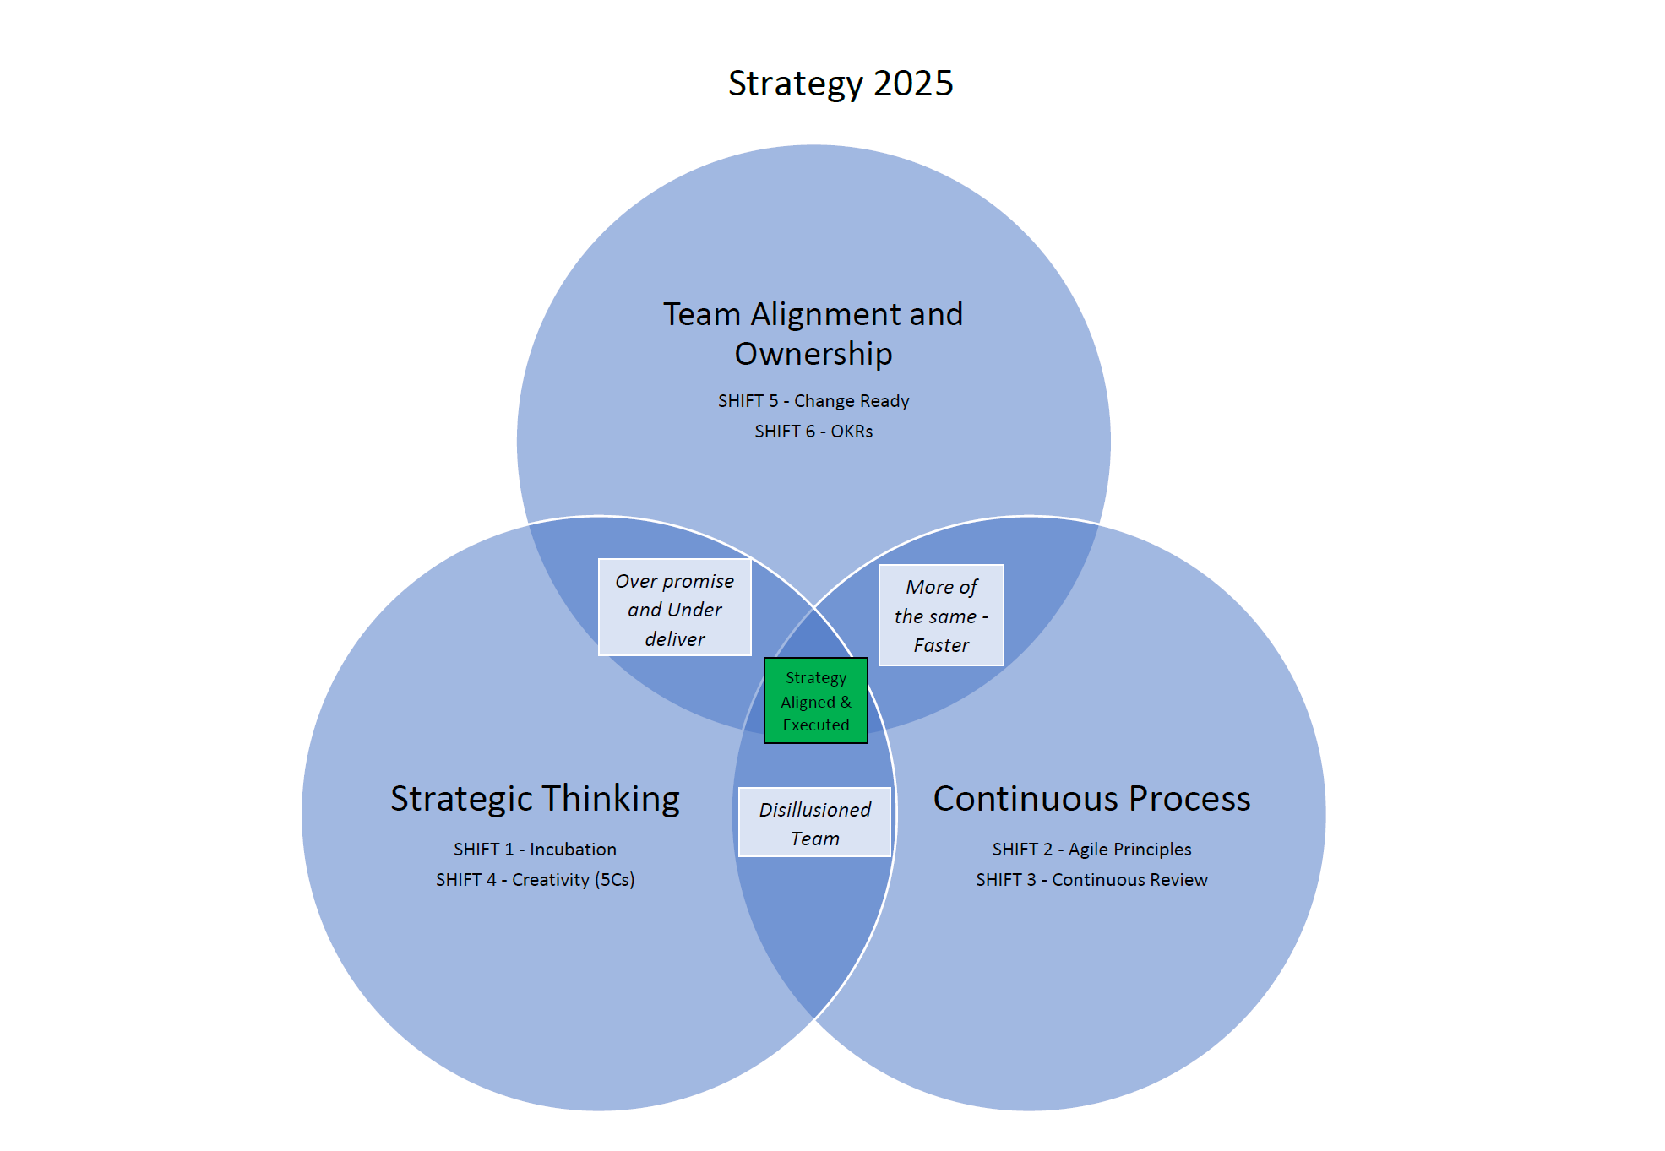
THE SWEET SPOT FOR LEADERS

Slide 11
What does the leader need to do differently?

Slide 12
THE LEADERS ROLE
ENGAGE board and executive
Ensure team are CAPABLE in strategic thinking and change
Less focus on the plan – MORE PLANNING
More REGULAR REVIEWS - market shifts, VUCA, technology
Consider INDEPENDENT external facilitation

Slide 13

Summary from today
We covered:
Why Strategic Planning and why it pays
The causes of failure in Strategic Planning
Why the approach to strategic planning needs to shift
What are the shifts
What the leader needs to do differently
Michael Burke
Burke Corporate Advisory Group
www.bcag.net.au
mburke@bcag.net.au

