Slide 1

Creating a culture of high performance for 2020/2021
Facilitated by Michael Burke

Slide 2
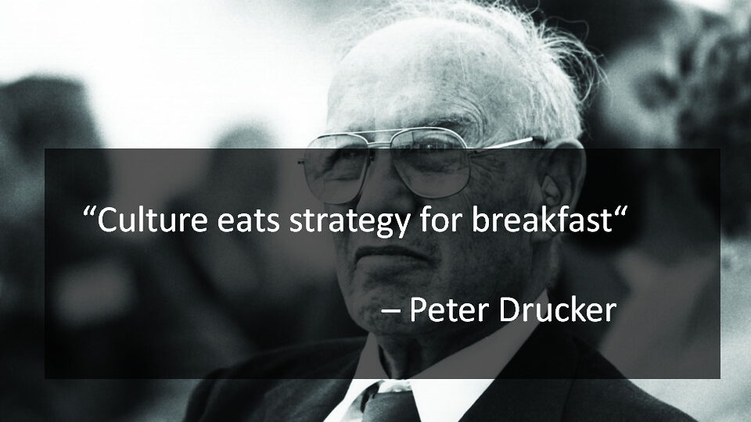

Slide 3
8 elements to a high performance culture. Where is your biggest gap?

Slide 4
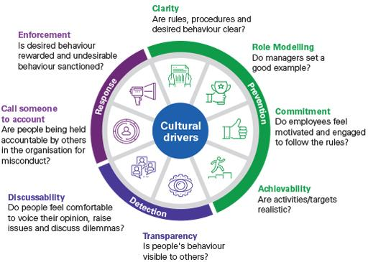

8 elements to a high performance culture
Ref: KPMG Culture Model: https://home.kpmg/au/en/home/insights/2018/08/soft-controls-model.html

Slide 5
Exercise
Work on a gap analysis based on each of the 8 elements of the KPMG Culture Model
How you could bridge the gap on your top 1-2 areas

Slide 6
Using core values for accelerating decision making across the team
Notes:
1

Slide 7
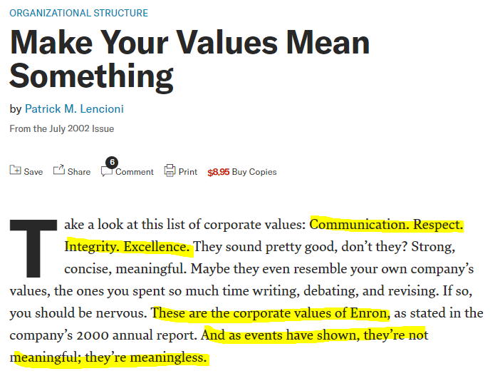
Permission-to-play values
Reflect the minimum behavioral and social standards
Core values
Deeply ingrained principles that guide all of a companies actions
Ref: https://hbr.org/2002/07/make-your-values-mean-something

Slide 8
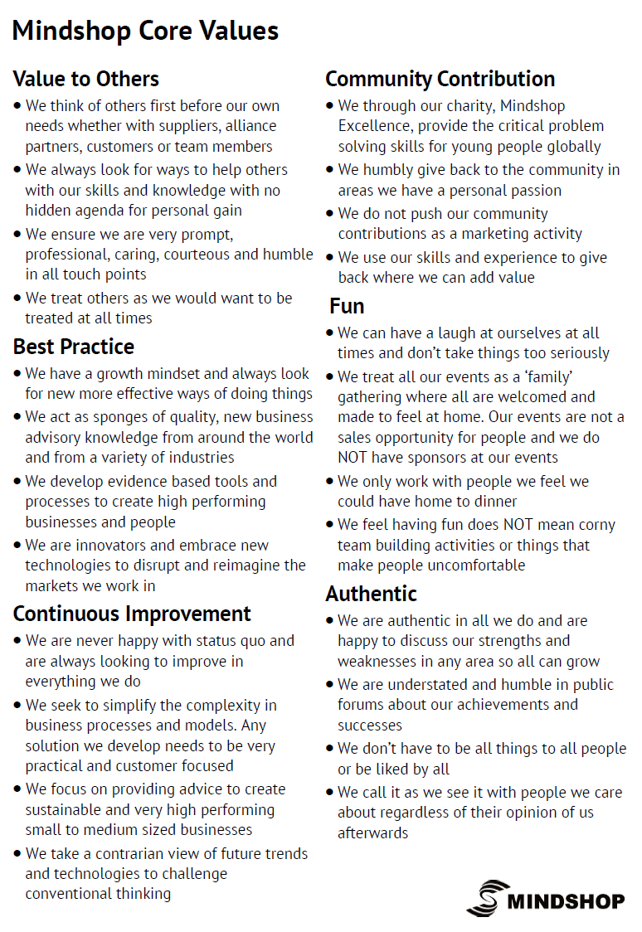
A5 insert provided to all new Mindshop customers
Seeks to explain how Mindshop’s core values are shown in their ‘actions’ in the field and internally.
Drives their decision making
Notes:
3 minutes (Note if you don’t want to use Mindshop’s here on these slides replace with your own to make the same point)
State that as just mentioned Mindshop fleshes out in layman's terms what each means (read the points on the left of this slide) and then read out a view of the points under each of the core values as examples. Gather feedback on what peoples thoughts are on that approach before moving on

Slide 9
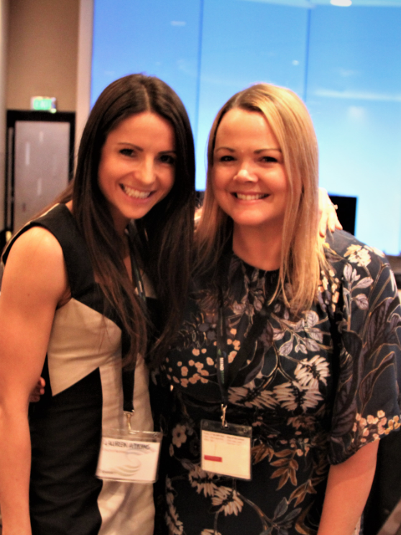
Key steps – Fast track decisions using core values
Make a list of core values
Test: “Are they permission to play OR genuinely core values?”
Define how those core values are demonstrated in the field and with the team
Communicate them with the team
Use them as the BIGGEST filter on your next decisions

Slide 10
Summary from today
Culture eats strategy for breakfast
Great examples of high performance cultures
8 elements to a high performance culture including your specific gaps
Using core values for rapid decision making
What is your key insight from the day?

